Slide 1
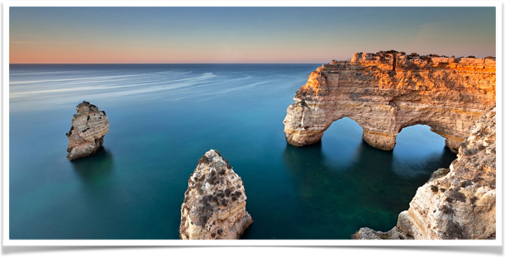

Building a basic search engine with apache lucene No.2
ZHICHENG PAN 104639463 2017-12-03

Slide 2
outline
PROJECT INTRODUCTION
VIDEO REPRESENTATION
HOW TO IMPLEMENT STEP BY STEP
FUTURE WORK

Slide 3
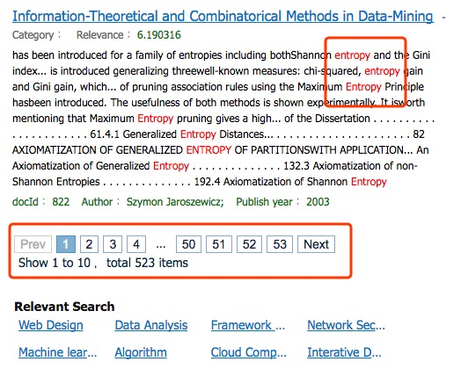
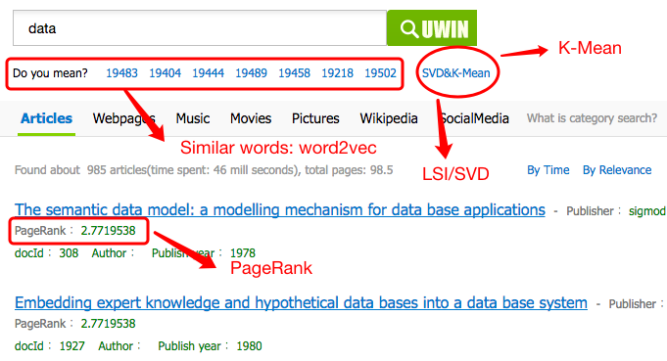
PROJECT INTRODUCTION
1. Enhancing the first version: highlighter, pagination 2. Adding PageRank feature 3. Adding word2vec to find similar words 4. Adding LSI/SVD to generate each document vectors 5. Using K-mean to cluster document vectors

Slide 4
VIDEO REPRESENTATION
VIDEO REPRESENTATION 1. show the key modules of the project 2. show pageRank running effective 3. show word2vec running effective 4. show SVD, K-Mean clustering running effective

Slide 5
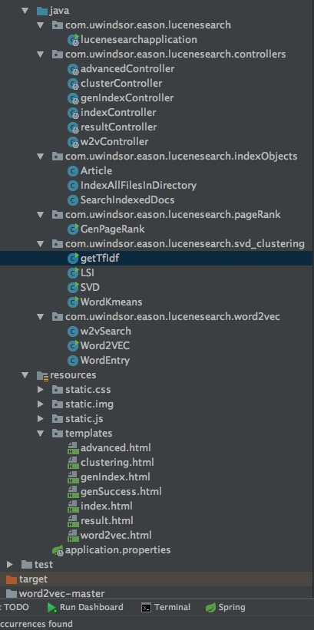
IMPLEMENT STEP1: project modules
1. establish the environment a). Maven 3.5, JDK 1.8, IntelliJ IDEA 14 (with Tomcat) b). Spring Boot 1.5.8, add dependencies: lucene, web, thymeleaf, la4j, suggest, highlighter, memory
2. modules of project a). Index and Searching generate and search index data b). PageRank calculate the citation and produce Ranking value c). LSI/SVD generate a vector for a document d). K-Mean clustering clustering the documents based on vectors of documents e). word2vec calculate distance for each word, find similar words for a keyword

Slide 6
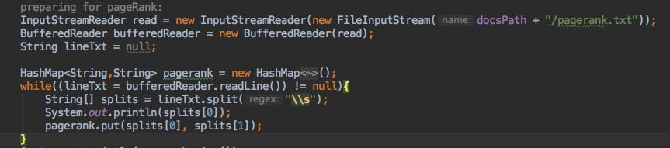
IMPLEMENT STEP 2: pagerank
1. Calculate the pageRank value based on citation graph no pageRank value : default 1, not boost score value pageRank value: > 1, boost score value
2. Loading the pageRank value
3. One way: boosting up the score value for a specific field

Slide 7
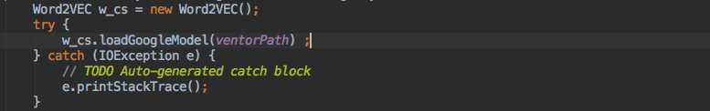
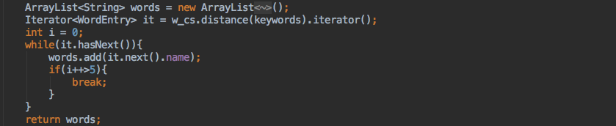
IMPLEMENT STEP 5: word2vec
1. Install the word2vec, training the algorithm with all collected txt data 2. Load the vectors.bin that store vectors for each word
3. Finding the similar words

Slide 8
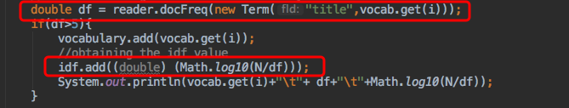
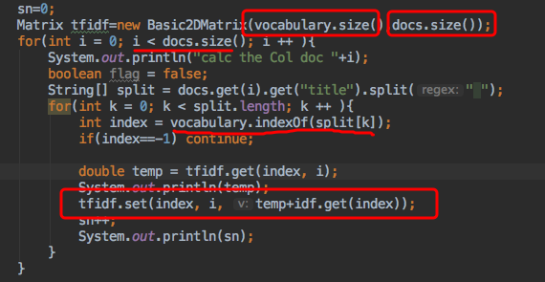
IMPLEMENT STEP 3: lsi/svd
1. LSI, generate a Tf-Idf Matrix for all documents 1.1 calculate Idf value based on Tf provided by Lucene 1.2 Form a Tf-Idf Matrix

Slide 9
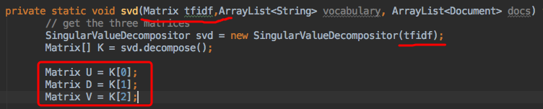
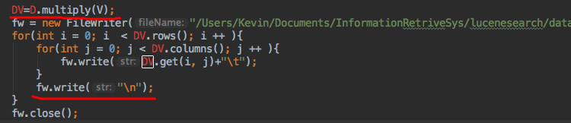
IMPLEMENT STEP 3: lsi/svd
1. SVD: used to generate a whole vector for each document U: SVD term matrix D: Singular matrix V: SVD doc matrix decompose the Tf-Idf Matrix generate by LSI Multiply matrix D and matrix V to obtain DV matrix, which is represent a whole vector for each document

Slide 10
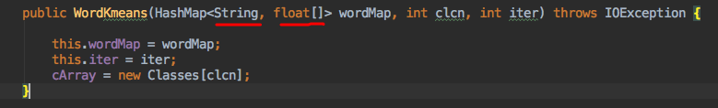
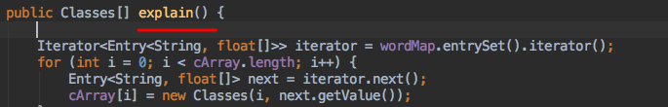
IMPLEMENT STEP 4: K-Mean clustering
1. K-Mean clustering algorithm measure distance between each observation partition n observations into k clusters
2. Using K-Mean clustering algorithm to cluster the documents

Slide 11
FUTRE WORK
FUTRE WORK
A. Technical Improvements a). Integrate Data Visualization features on webapge b). Try to implement ”Search in Results” module B. Algorithms Enhancement a). Fixing errors on K-Mean algorithm b). Extract Cluster Labels & Display dynamically c). Integrate Recommendations algorithms d). Optimize algorithms and run big data set

Slide 12

THANK YOU ! Q & A

